Slide 1
The Distance and Midpoint Formulas and Other Applications
10.7

Slide 2
The Pythagorean Theorem
In any right triangle, if a and b are the lengths of the legs and c is the length of the hypotenuse, then
a² + b² = c².
Hypotenuse
c
b
Leg
a
Leg

Slide 3
The Principle of Square Roots
For any nonnegative real number n,
If x² = n, then

Slide 4
Example
How long is a guy wire if it reaches from the top of a 14-ft pole to a point on the ground 8 ft from the pole?
Solution
d
We now use the principle of square roots. Since d represents a length, it follows that d is the positive square root of 260:
14
8

Slide 5
Two Special Triangles
When both legs of a right triangle are the same size, we call the triangle an isosceles right triangle.
45°
c
a
45°
a
A second special triangle is known as a 30º-60º-90º right triangle, so named because of the measures of its angles. Note that the hypotenuse is twice as long as the shorter leg.
30º
2a
60º
a

Slide 6
Example
The hypotenuse of an isosceles right triangle is 8 ft long. Find the length of a leg. Give an exact answer and an approximation to three decimal places.
Exact answer:
Approximation:
45º
8
a
45º
a

Slide 7
Example
The shorter leg of a 30º-60º-90º right triangle measures 12 in. Find the lengths of the other sides. Give exact answers and, where appropriate, an approximation to three decimal places.
Solution
The hypotenuse is twice as long as the shorter leg, so we have
30º
c = 2a
= 2(12) = 24 in.
c
Exact answer:
Approximation:
60º

Slide 8
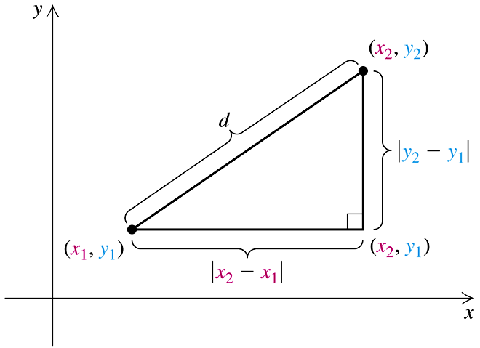
The Distance Formula
The distance d between any two points (x₁, y₁) and (x₂, y₂) is given by

Slide 9
Example
Find the distance between (3, 1) and (5, –6). Find an exact answer and an approximation to three decimal places.
Solution
Substitute into the distance formula:
Substituting
This is exact.
Approximation

Slide 10
The Midpoint Formula
If the endpoints of a segment are (x₁, y₁) and (x₂, y₂), then the coordinates of the midpoint are
(To locate the midpoint, average the x-coordinates and average the y-coordinates.)
y
(x₂, y₂)
(x₁, y₁)
x

Slide 11
Example
Find the midpoint of the segment with endpoints (3, 1) and (5, –6).
Solution
Using the midpoint formula, we obtain

