Slide 1
7.3 – Graphs of Functions 7.4 – Algebras of Functions

Slide 2
Equations of Lines
Standard form: Ax + By = C
Slope-intercept form: y = mx + b
Point-slope form: y − y₁ = m(x − x₁)

Slide 3
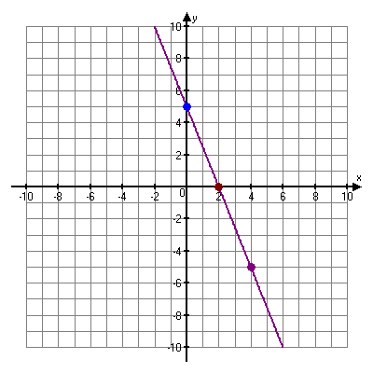
Example
Graph 5x + 2y = 10.
Solution
Let x = 0 to find the y-intercept:
5 • 0 + 2y = 10
2y = 10
y = 5
The y-intercept is (0, 5).
Let y = 0 to find the x-intercept:
5x + 2• 0 = 10
5x = 10
x = 2
The x-intercept is (2, 0).
y-intercept (0, 5)
x-intercept (2, 0)
5x + 2y = 10

Slide 4
Graph: 3x + 4y = 12
Example
Solution
Rewrite the equation in slope-intercept form.

Slide 5
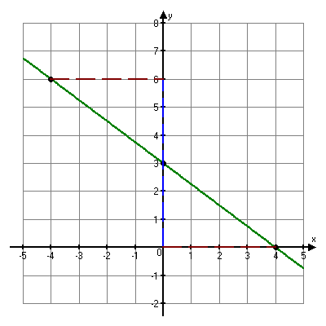
Solution
The slope is −3/4 and the y-intercept is (0, 3).
We plot (0, 3), then move down 3 units and to the right 4 units.
An alternate approach would be to move up 3 units and to the left 4 units.
left 4
(−4, 6)
up 3
(0, 3)
down 3
right 4
(4, 0)

Slide 6
Linear Function
A function described by an equation of the form f(x) = mx + b is a linear function. Its graph is a straight line with slope m and y-intercept at (0, b).
When m = 0, the function is described by f(x) = b is called a constant function. Its graph is a horizontal line through (0, b).

Slide 7
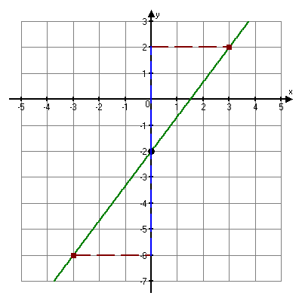
Graph:
Example
Solution
The slope is 4/3 and the y-intercept is (0, −2).
We plot (0, −2), then move up 4 units and to the right 3 units.
We could also move down 4 units and to the left 3 units.
Then draw the line.
right 3
(3, 2)
up 4 units
(0, −2)
down 4
(−3, −6)
left 3

Slide 8
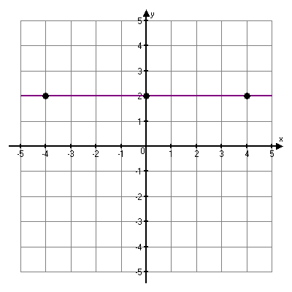
Graph y = 2
Example
Solution
This is a constant function. For every input x, the output is 2. The graph is a horizontal line.
y = 2
(0, 2)
(−4, 2)
(4, 2)

Slide 9
Nonlinear Functions
A function for which the graph is not a straight line is a nonlinear function.
Type of function | Example
Absolute-value | f(x) = |x + 2|
Polynomial | p(x) = x⁴ + 3x² – 2
Quadratic | h(x) = x² – 4x + 2
Rational

Slide 10
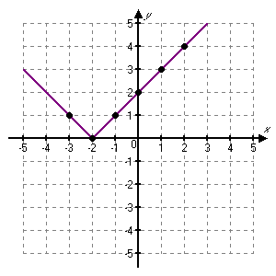
Example
Graph the function given by g(x) = |x + 2|.
Solution
Calculate function values for several choices of x and list the results in a table.
x | g(x) = |x + 2| | (x, f(x))
1 | 3 | (1, 3)
2 | 4 | (2, 4)
–1 | 1 | (–1, 1)
–2 | 0 | (–2, 0)
–3 | 1 | (–3, 1)
0 | 2 | (0, 2)

Slide 11
The Algebra of Functions
If f and g are functions and x is in the domain of both functions, then:

Slide 12
Example
For
find the following.
a) ( f + g)(4) b) ( f – g)(x)
c) ( f /g)(x) d)
Solution
a) Since f (4) = –8 and g(4) = 13, we have
( f + g)(4) = f (4) + g(4) = –8 + 13 = 5.

Slide 13
Solution
b) We have,
c) We have,
d) Since f (–1) = –3 and g(–1) = –2, we have

Slide 14
Example
find the domains of
Solution
Domain of f + g, f – g, and

Slide 15
Solution continued
To find the domain of f /g, note that
can not be evaluated if x + 1 = 0 or x – 2 = 0.
Thus the domain of f /g is

Slide 16
Examples
Find the following
(f+g)(x) b. (f – g)(x) c. (fg)(x) d. (f/g)(0)
Evaluate when f(x) = x² + 1 and g(x) = x - 4

Slide 17
Group Exercise
For the functions
(f+g)(x)
(f – g)(x)
(fg)(x)
(f/g)(0)
(f+g)(-1)
(fg)(0)
(f/g)(1)

