Slide 1
Sections 11.3 - 11.4 Rates of Change and the Derivative

Slide 2
Example
The revenue generated by producing and selling widgets is given by R(x) = x (75 – 3x) for 0 ≤ x ≤ 20.
a) Graph the revenue function.
b) What is the change in revenue if production increases from 9 to 12?
R(12) – R(9) = $468 – $432 = $36.
c) What is the average rate of change in revenue (per unit change in x) if production changes from 9 to 12?

Slide 3
The Rate of Change
For y = f (x), the average rate of change from x = a to x = b is
This quantity is the slope m of a secant line.

Slide 4
Secant and Tangent Lines
Secant Line – A line passing through two points on a graph of a function.
Q
f(x₁)
P
f(x₂)
x₁
x₂
Tangent Line – A line that touches the graph at a point. The tangent line may cross the graph at other points depending on the graph.
Q
f(x₁)
P
Q
Q
f(x₂)
f(x₂)
f(x₂)
x₁
x₂
x₂
x₂
http://www.slu.edu/classes/maymk/Applets/SecantTangent.html

Slide 5
Slope of the Tangent Line
Now let x₁ = a and x₂ = a+h, where h is the distance from x₁ to x₂. This changes the formula to:
Q
Q
f(x₁)
P
P
f(x₂)
f(a)
f(a+h)
x₁
x₂
a
a + h

Slide 6
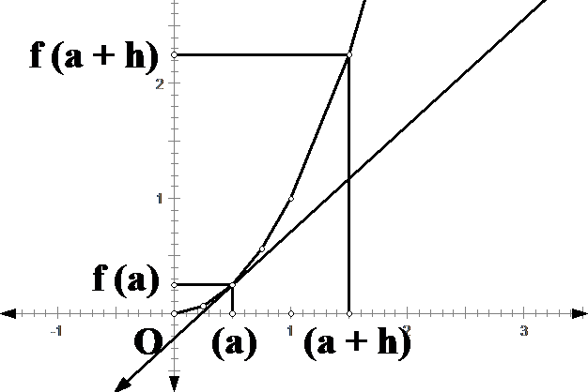
Secant line
Q
Tangent
f (a + h) – f (a)
P
Let h approach 0
h

Slide 7
Slope of the Tangent Line
To determine the slope of the tangent line using this form, let a + h approach a. This is equivalent to allowing h → 0.
Q
f(a)
P
f(a+h)
←
a
a + h
means h → 0

Slide 8
Instantaneous Rate of Change
Given y = f (x), the instantaneous rate of change at x = a is
provided that the limit exists. It can be interpreted as the slope of the tangent at the point (a, f (a)).
Slope of the tangent = instantaneous rate of change.

Slide 9
Example
Find an equation of a tangent line to f (x) = x² at
x = 3
x = -1
x = 4

Slide 10
The Derivative
For y = f (x), we define the derivative of f at x, denoted f ’ (x), to be
if the limit exists.
If f’(x) exists at a point a, we say f is differentiable at a.
Notations

Slide 11
Finding the Derivative
To find f ’ (x), we use a four-step process:
Step 1. Find f (x + h)
Step 2. Find f (x + h) – f (x)
Step 3. Simplify
Step 4. Evaluate

Slide 12
Example
Find the derivative of f (x) = x ² – 3x.
Step 1. f (x + h) = (x + h)² – 3(x + h) = x² + 2xh + h² – 3x – 3h
Step 2. f (x + h) – f (x) = (x² + 2xh + h² – 3x – 3h ) - ( x ² – 3x ) = 2xh + h² – 3h
Step 3. Find
Step 4. Find

Slide 13
Example
Find the slope of the tangent to the graph of f (x) = x ² – 3x at x = 0, x = 2, and x = 3.
Solution: In example 2 we found the derivative of f(x) to be
f ’ (x) = 2x – 3
Hence
f ’ (0) = -3
f ’ (2) = 1
f ’ (3) = 3
Find an equation of the tangent line to the graph of f(x) at x = 2. Use a graphing calculator to verify your answer.

Slide 14
Finding slope of the tangent under the “Calc” menu.
Drawing tangent line under the “draw” menu.
slope
tangent equation

Slide 15
Interpretations of the Derivative
If f is a function, then f ’ (x) is a new function that represents
the slope of the tangent line to the graph of f at x.
the instantaneous rate of change of f (x) with respect to x.
the velocity of the object at time x if f (x) is the position function of a moving object.

Slide 16
Example
Find the derivative of f (x) = 2x – 3x².
Step 1. f (x + h) = 2(x + h) – 3(x + h)² = 2x + 2h – 3(x² +2xh + h²)
= -3x² – 6xh – 3h² + 2x + 2h
Step 2. f (x + h) – f (x) = (-3x² – 6xh – 3h² + 2x + 2h) – (2x – 3x² )
= 2h– 6xh - 3h²
Step 3.
Step 4.

