Slide 1
2.5
Continuity

Slide 2
Discontinuity
Infinite Discontinuity
Jump Discontinuity
○
|
a
|
c
|
b
|
a
|
c
|
b
Removable
Discontinuity
•
o
|
a
|
c
|
b

Slide 3
Definition
A function is continuous at a number a if
This means that
This implicitly requires that the limit must exist and f (a) must be defined.
The function is discontinuous at x = a if f (a) is undefined. This fact helps us quickly locate where the function is discontinuous.

Slide 4
Example
Graph the function
Is f(x) continuous at 3?
Yes
Is f(x) continuous at 2?
No

Slide 5
Example
Determine where the following functions are NOT continuous, and discuss the discontinuity there.

Slide 6
Charles’s Law and Absolute Zero
What is the coldest temperature?
-273.15⁰ ( 0 in Kelvin scale, the so-called absolute zero)
How do scientists determine that it cannot be colder than 0 K?
Temp | -40 | -20 | 0 | 20 | 40 | 60 | 80
V(liters) | 19.1482 | 20.7908 | 22.4334 | 24.0760 | 25.7186 | 27.3612 | 29.0038
The volume of hydrogen gas depends on its temperature:
In 2003, researchers produced a supercold gas that has the temperature of about -273.14999999955⁰C

Slide 7
Recall: One Sided Limits
Left-Hand Limit: The limit of f as x approaches a from the left equals L is denoted
|
a
Right-Hand Limit: The limit of f as x approaches a from the right equals L is denoted
|
a

Slide 8
One-sided Continuity
A function f is continuous from the right at a if
and f is continuous from the left at a if
●
○
| a
●
○
| a

Slide 9
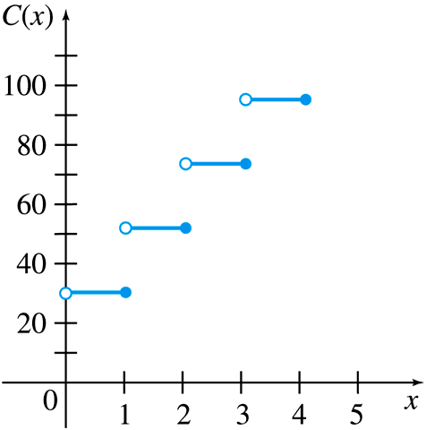
Example
Is C(x) continuous from the left at 1?
Is C(x) continuous from the right at 1?

Slide 10
Continuity on an Interval
A function f(x) is continuous on a closed interval [a,b] if it is continuous
at every number in the open interval (a,b)
from the right at x = a
from the left at x = b.
●
○
●
| b
| a

Slide 11
Example
Determine the interval of continuity.

Slide 12
Examples
Find all values of x where the function is discontinuous.

Slide 13
Intermediate Value Theorem (IVT)
Suppose that f (x) is continuous on the closed interval [a, b] and let N be any number between f (a) and f (b). Then there exists a number c in (a, b) such that f (c) = N.
f(a)
f(c)=N
f(b)
f
a
c
b

Slide 14
Example
Use the IVT to show that there is a root of the given equation in the specified interval.

Slide 15
Group Work
Discuss the discontinuity of the function

