Slide 1
7.2
Volume: The Disk Method

Slide 2
Example
Suppose I start with this curve.
Rotate the curve about the x-axis to obtain a nose cone in this shape.
How could we find the volume of this cone?

Slide 3
One way would be to cut it into a series of thin slices (flat cylinders) and add their volumes.
The volume of each flat cylinder (disk) is:
r = the y value of the function
thickness = dx
If we add the volumes, we get:

Slide 4
If y = f(x) is the equation of the curve whose area is being rotated about the x-axis, then the volume is
Disk Method
a and b are the limits of the area being rotated
dx shows that the area is being rotated about the x-axis

Slide 5
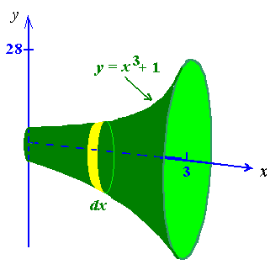
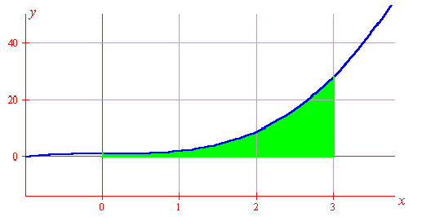
Example
Find the volume of the solid obtained by rotating the region bounded by the given curves

Slide 6
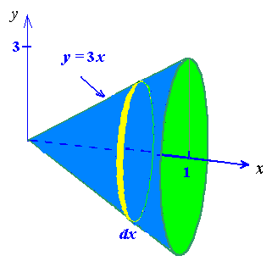
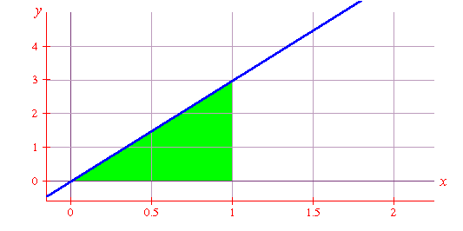
Example
Find the volume of a cone whose radius is 3 ft and height is 1ft.

Slide 7
Example
The region between the curve , and the
y-axis is revolved about the y-axis. Find the volume.
y
x
We use a horizontal disk.
The thickness is dy.
The radius is the x value of the function .
volume of disk

Slide 8
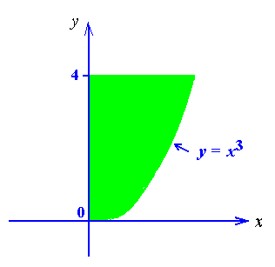
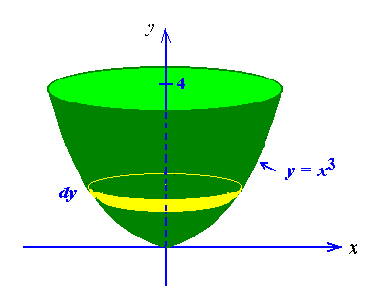
Example
Find the volume of the solid of revolution generated by rotating the curve y = x³ between y = 0 and y = 4 about the y-axis.

Slide 9
The natural draft cooling tower shown at left is about 500 feet high and its shape can be approximated by the graph of this equation revolved about the y-axis:
The volume can be calculated using the disk method with a horizontal disk.

Slide 10
Example
The region bounded by
and is revolved about the y-axis.
Find the volume.
If we use a horizontal slice:
The “disk” now has a hole in it, making it a “washer”.
The volume of the washer is:
outer
radius
inner
radius

Slide 11
Washer Method
This application of the method of slicing is called the washer method. The shape of the slice is a circle with a hole in it, so we subtract the area of the inner circle from the area of the outer circle.
The washer method formula is:

Slide 12
Example
If the same region is rotated about the line x=2:
The outer radius is:
The inner radius is:
r
R

Slide 13
Method of Slicing
1
Sketch the solid and a typical cross section.
2
Find a formula for V(x).
3
Find the limits of integration.
4
Integrate V(x) to find volume.

Slide 14
Example
Find the volume of the pyramid:
3
Consider a horizontal slice through the pyramid.
The volume of the slice is s²dh.
If we put zero at the top of the pyramid and make down the positive direction, then s=h.
3
3
0
h
s
This correlates with the formula:
dh
3

Slide 15
Examples
Find the volume of the solid of revolution generated by rotating the curve y = x² , x = 0 and y = 4 about the given line.
y-axis
x-axis
the line x = 3
the line y = - 2

