Slide 1
4.5
Inhomogeneous Equations:
Method of Undetermined Coefficients

Slide 2
Inhomogeneous Equations
$$y^{′′}+py^{′}+qy=f(t)$$
where$f(t)$ is called forcing term, or inhomogeneous term.
To find a particular solution $y_{p}(t)$ to the equation, we try the following form:
If $f\left(t\right)=Ae^{rt}$:
$y_{p}=ae^{rt}$
If $f\left(t\right)=P\left(t\right) polynomial$:
$y_{p}=p(t)$ of the same degree
If $f\left(t\right)=A\cos{βt OR A\sin{βt}}$:
$y_{p}=a\cos{βt}+b\sin{βt}$

Slide 3
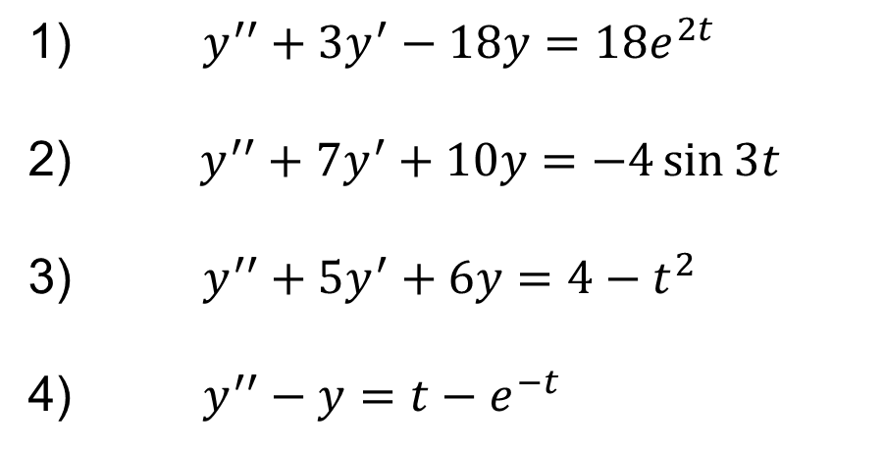
Examples
Find a particular solution to the following equations:
$y^{′′}+3y^{′}−18y=18e^{2t}$
$y^{′′}+7y^{′}+10y=−4\sin{3t}$
$y^{′′}+5y^{′}+6y=4−t^{2}$
$y^{′′}−y=t−e^{−t}$

Slide 4
Theorems
A particular solution to the equation
$$y^{′′}+py^{′}+qy=αf\left(t\right)+βq(t)$$
has the form $y_{p}=αy_{f}\left(t\right)+βy_{g}(t)$ where
$y_{f}(t)$ is a solution to the equation $y^{′′}+py^{′}+qy=f(t)$ and $y_{g}(t)$ is a solution to the equation $y^{′′}+py^{′}+qy=g(t)$.
If $y_{p}(t)$ is a solution to the equation $y^{′′}+py^{′}+qy=f(t)$ and $y_{h}(t)$ is a solution to its associated homogeneous equation, then the general solution is of the form:
$$y(t)=y_{p}\left(t\right)+y_{h}(t)$$

Slide 5
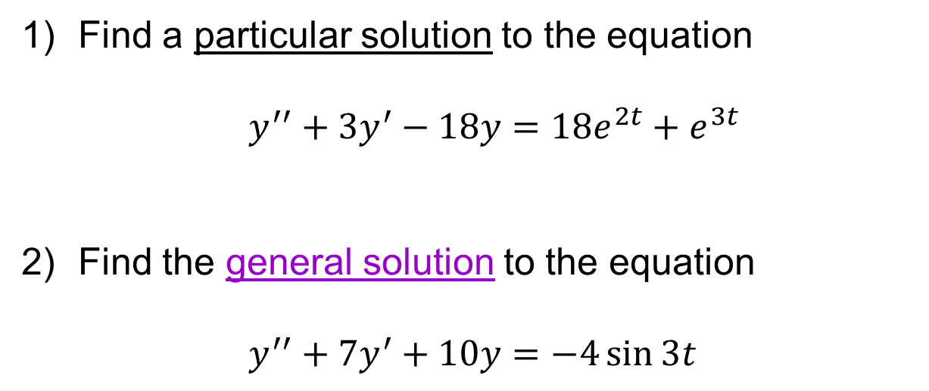
Examples
Find a particular solution to the equation
$y^{′′}+3y^{′}−18y=18e^{2t}+e^{3t}$
Find the general solution to the equation
$y^{′′}+7y^{′}+10y=−4\sin{3t}$

