Slide 1
5.2
Basic Properties of the
Laplace Tranform

Slide 2
Properties
Theorem:
If $f\left(t\right)$ is a piecewise differentiable function of exponential order and L$\left\{f\left(t\right)\right\}=F(s)$, then for large values of s,
L$\left\{f^{′}\left(t\right)\right\}=s∙F\left(s\right)−f(0)$
Examples:
$f\left(t\right)=\sin{t} →$ $F\left(s\right)=\frac{1}{s^{2}+1}$
L$\left\{f′\left(t\right)\right\}=$L$\left\{\cos{t}\right\}=s∙\frac{1}{s^{2}+1}−\sin{0=\frac{s}{s^{2}+1}}$
$f\left(t\right)=t^{2} →$ $F\left(s\right)=\frac{2}{s^{3}}$
L$\left\{f′\left(t\right)\right\}=$L$\left\{2t\right\}=s∙\frac{2}{s^{3}}−0^{2}=\frac{2}{s^{2}}$

Slide 3
Properties
Theorem:
If $f\left(t\right)$ and $g\left(t\right)$ are both piecewise continuous functions of exponential order and $a,b$are constants, then
L$\left\{a∙f\left(t\right)+b∙g(t)\right\}=a∙\text{L}\left\{f\left(t\right)\right\}+b∙\text{L}\{g\left(t\right)\}$
Examples: Find the Laplace Transform of
$f\left(t\right)=6e^{4t}−8+5\cos{4t}$
$f′′\left(t\right)$
$f^{′′′}\left(t\right)$

Slide 4
General Formulas
If L$\left\{f\left(t\right)\right\}=F(s)$, then for large values of s,
L$\left\{f^{′}\left(t\right)\right\}=s∙F\left(s\right)−f\left(0\right)$
L$\left\{f′′\left(t\right)\right\}=s^{2}∙F\left(s\right)−s∙f(0)−f′(0)$
L$\left\{f^{′′′}\left(t\right)\right\}=s^{3}∙F\left(s\right)−s^{2}∙f\left(0\right)−s∙f^{′}\left(0\right)−f′′(0)$
Example: Solve the O.D.E.
$y^{′′}+9y=0, y\left(0\right)=3, y^{′}\left(0\right)=4$
$→y(s)=\frac{3s+4}{s^{2}+9}$ $→$ $y\left(t\right)=3\cos{3t}+\frac{4}{3}\sin{3t}$

Slide 5
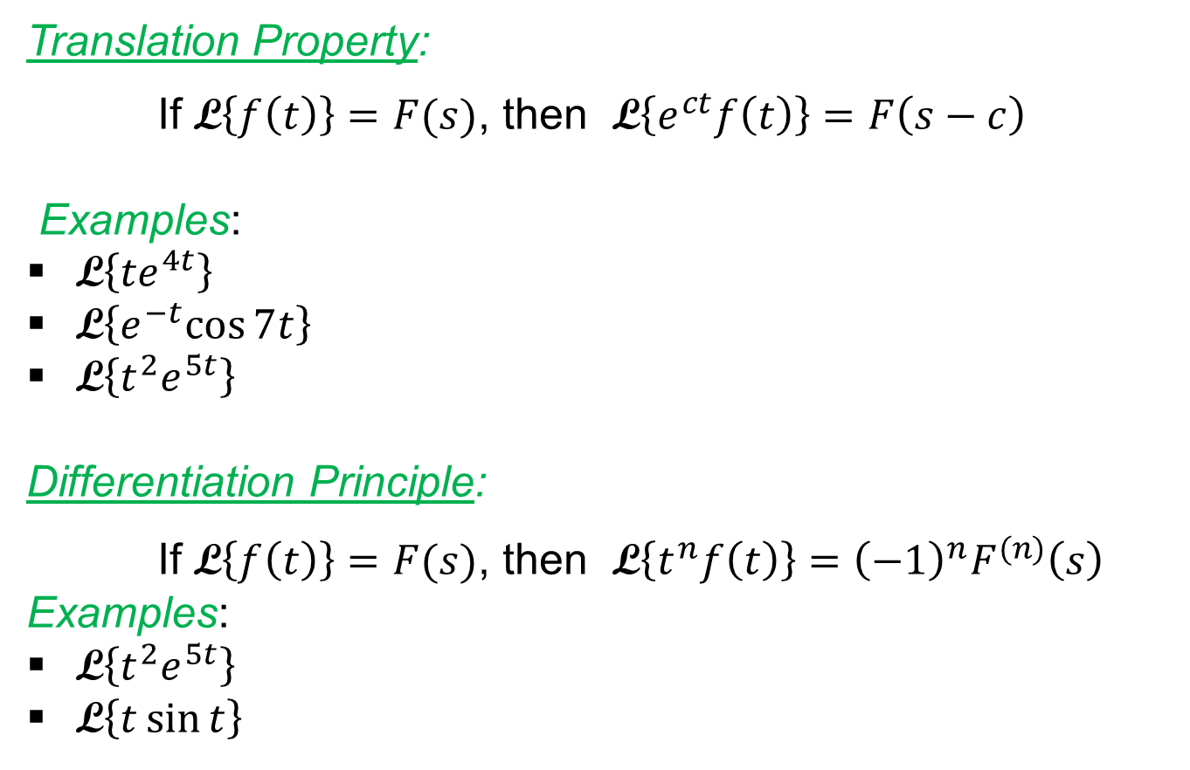
Properties
Translation Property:
If L$\left\{f\left(t\right)\right\}=F(s)$, then L$\left\{e^{ct}f\left(t\right)\right\}=F\left(s−c\right)$
Examples:
L$\left\{{te}^{4t}\right\}$
L$\left\{e^{−t}cos{7t}\right\}$
L$\left\{{t^{2}e}^{5t}\right\}$
Differentiation Principle:
If L$\left\{f\left(t\right)\right\}=F(s)$, then L$\left\{t^{n}f\left(t\right)\right\}={\left(−1\right)}^{n}F^{(n)}\left(s\right)$
Examples:
L$\left\{{t^{2}e}^{5t}\right\}$
L$\left\{t\sin{t}\right\}$

